Slide 1
Distributions in Statistics
Gaussian Distribution (Normal Distribution)
Conversion to Standard Normal Distribution (Z-Score)
Log Normal Distribution
Binomial Distribution
Bernoulli Distribution

Slide 2
Gaussian Distribution (Normal Distribition)

Slide 3









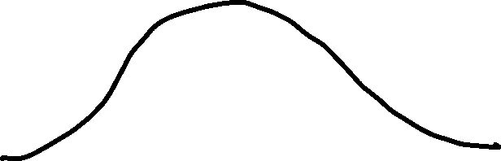





Slide 4



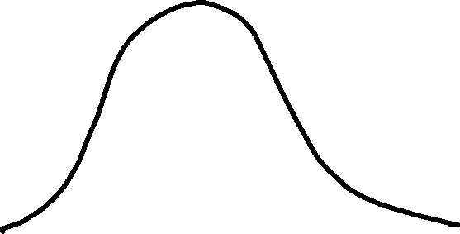


















Slide 5
Conversion to “Standard” Normal Distribution
Standard Scores or Sigma or Z-Score

Slide 6
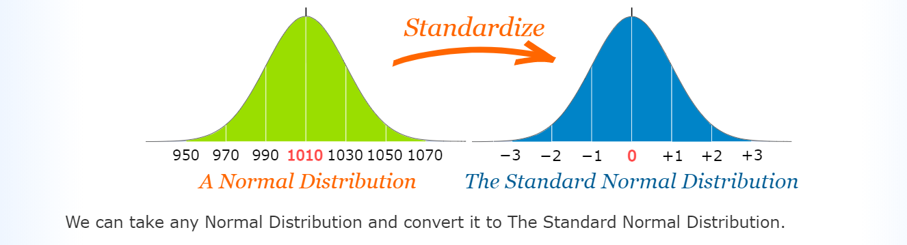
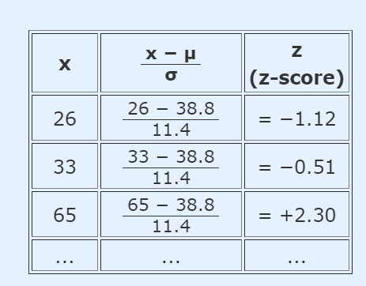

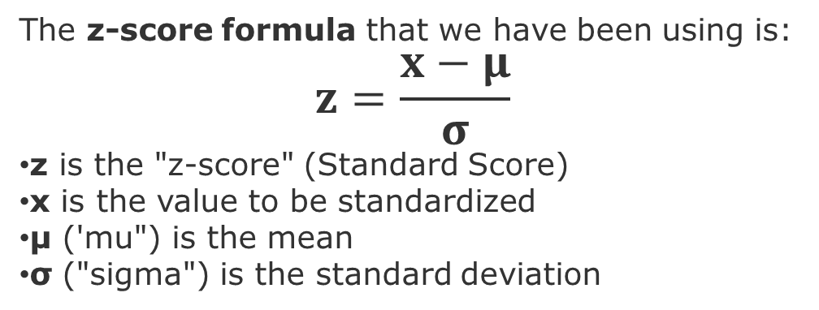
https://www.mathsisfun.com/data/standard-normal-distribution.html
So to convert a value to a Standard Score ("z-score"):
first subtract the mean,
then divide by the Standard Deviation
The z-score formula that we have been using is:
$$z=\frac{x−μ}{σ}$$
z is the "z-score" (Standard Score)
x is the value to be standardized
μ ('mu") is the mean
σ ("sigma") is the standard deviation

Slide 7
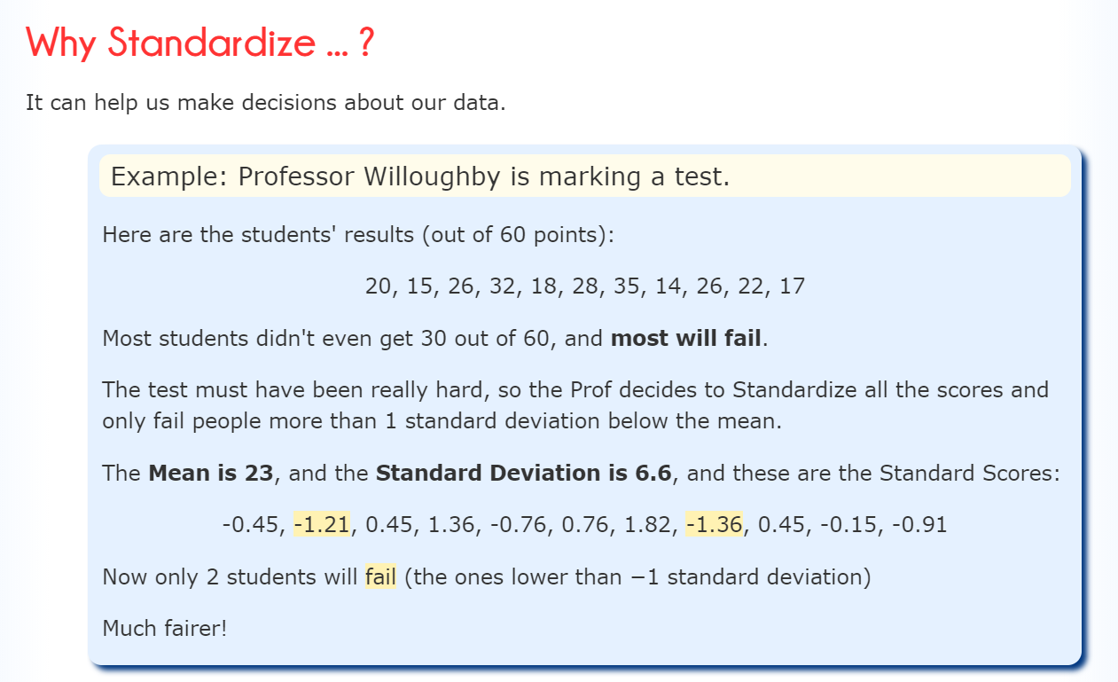

Slide 8
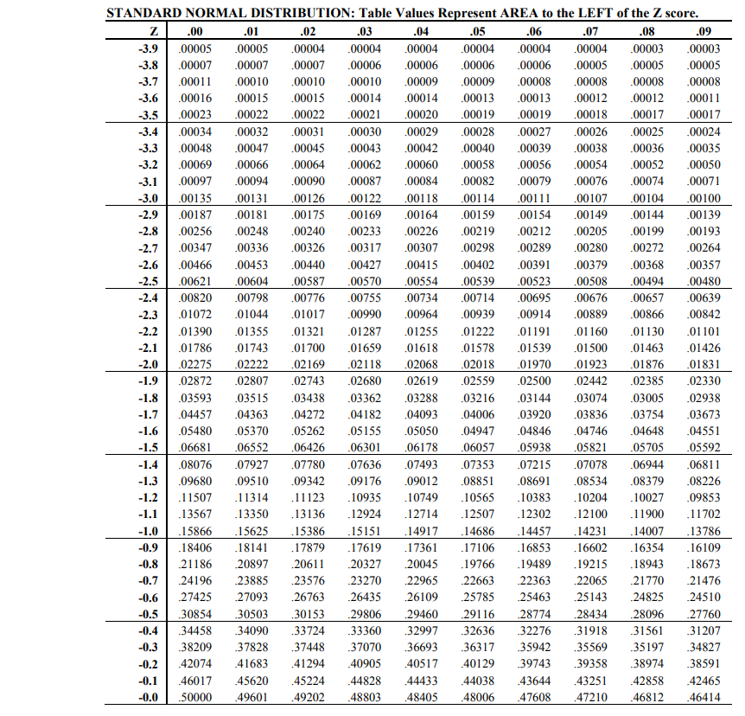
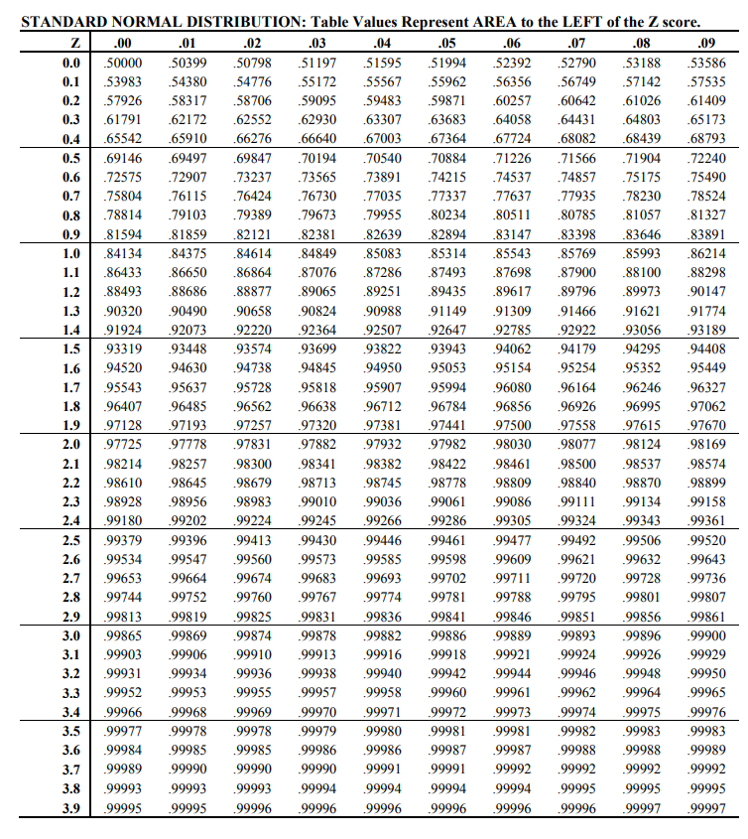

Slide 9
How to use the Z Table: https://www.youtube.com/watch?v=Oyjp6Ke8V9I
Krish Naik Youtube video on Z-Scores: https://www.youtube.com/watch?v=4Fta6KQ1QHQ

Slide 10
Log Normal Distribution

Slide 11

































Slide 12






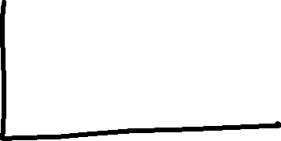


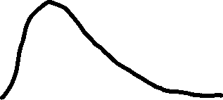






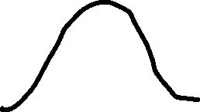




Link for Basics of Normal and Binomial distributions:
https://www.mathsisfun.com/data/index.html

Slide 13




































Converting to Standard Normal Distribution
https://www.youtube.com/watch?v=sPzPEeJ4OQ4&list=PLZoTAELRMXVMhVyr3Ri9IQ-t5QPBtxzJO&index=4

Slide 14
Binomial Distribution
365 Data Science: https://www.youtube.com/watch?v=_FbZI9mtSSM
StatsQuest with Josh Starmer : https://www.youtube.com/watch?v=J8jNoF-K8E8

Slide 15
Statistics Playlist by Krish Naik: https://www.youtube.com/watch?v=sPzPEeJ4OQ4&list=PLZoTAELRMXVMhVyr3Ri9IQ-t5QPBtxzJO&index=4

